Slide 1
Research Platform for Custom Memory Cube
Dr. Herman Lam
Assoc. Professor of ECE
University of Florida
Yu Zou
Vinayak Deshpande
Peter Harduvel (UG)
JeshalraThakaria (volunteer)
Raviteja Voora (volunteer)
Notes:
Add names of the volunteer students

Slide 2
Outline
Review & overview
Performance measurements on Merlin board
Mapping notional CMC to Merlin board
Validation of performance measurements on Merlin board
Validation using HMC simulator
Simulator selection (simulators studied)
System C HMC simulator from Micron
System C HMC simulator results
Validation of PERFMON code modification (Convey testbench)
Application exploration using HT
Bloom filter demos
Sorting algorithms
Going forward
* DRE: Data rearrangement/reordering engine ** CMC Computational Memory Cube

Slide 3
Outline
Review & overview
Performance measurements on Merlin board
Mapping notional CMC to Merlin board
Validation of performance measurements on Merlin board
Validation using HMC simulator
Simulator selection (simulators studied)
System C HMC simulator from Micron
System C HMC simulator results
Validation of PERFMON code modification (Convey testbench)
Application exploration using HT
Bloom filter demos
Sorting algorithms
Going forward
* DRE: Data rearrangement/reordering engine ** CMC Computational Memory Cube

Slide 4
Notional CMC Architecture*
Based on Nair et al.* : an HMC with a user-programmable logic layer
A, B, C, D, and : performance-measurement points of interest
* Nair, R., et al. "Active Memory Cube: A processing-in-memory architecture for exascale systems.“ IBM Journal of Res. & Development 59.2/3 (2015): 17-1.

Slide 5
DRE* Prototype on CMC Architecture
VB3
VB2
VB3
VB1
View buffer (VB) can be set up on host (design option 1), inside the HMC (design option 2) or inside CMC logic (design option 3)
* DRE: Data Reordering/Rearrangement Engine Lawrence Livermore Nat. Labs

Slide 6
Performance Measurement on Merlin Board
CMC platform on Merlin board
*
Instrumented Merlin infrastructure with hardware performance monitors
A’, B’, C’, D’, M1, M2, M3, M4, M5, and E’
Progress: Able to measure all listed parameters except:
M4, M5: Exploring with help from Convey
E’: Exploring with help with Micron under NDA
VB*: View Buffer

Slide 7
Mapping Notional CMC onto Merlin Board
Merlin board
Case study: model of a notional CMC
Simplifying assumption:
For this model, this part of CMC is assumed to have an HMC architecture

Slide 8
Model of CMC-to-Merlin Mapping
Model of notional CMC
CMC platform on Merlin board
Latency A = ctrl signal transfer time B + latency C + result transfer time B
Ctrl signal transfer time B : time to transfer control signals between host and CMC
Data transfer time B: time for host access to obtain result (e.g., transfer from view buffer)
Latency C = delay TSV* + latency C’ – delay D’minusE’
Delay D’minusE’ = latency D’ – latency E’
* delay TSV= between DRE core and switch, time to transfer a request +
time to transfer response of that request
Latency: round-trip delay from input into a point in the system to desired outcome

Slide 9
Outline
Review & overview
Performance measurements on Merlin board
Mapping notional CMC to Merlin board
Validation of performance measurements on Merlin board
Validation using HMC simulator
Simulator selection (simulators studied)
System C HMC simulator from Micron
System C HMC simulator results
Validation of PERFMON code modification (Convey testbench)
Application exploration using HT
Bloom filter demos
Sorting algorithms
Going forward
* DRE: Data rearrangement/reordering engine ** CMC Computational Memory Cube

Slide 10
Overlapping Memory Access: read/write ops
Observation: M1, M2, M3, (M4, M5, E’) have no significant difference

Slide 11
Overlapping Memory Access: DRE ops
Observation: M1, M2, M3, (M4, M5, E’) again have no significant difference
For overlapping memory access, discrepancy between M1, M2, M3, (M4, M5, E’) is hidden by “pipeline effect”
Thus, a simplified CMC mapping can be used

Slide 12
Simplified Notional CMC Modeling
For pipelined overlapping memory operations, estimate:
M1 = M2 = M3 = M4 = M5 = E’
Model of notional CMC
CMC platform on Merlin board
Latency A = ctrl signal transfer time B + latency C + result transfer time B
Ctrl signal transfer time B : time to transfer control signals between host and CMC
Data transfer time B: time for host access to obtain result (e.g., transfer from view buffer)
Latency C = latency C’ – delay D’minusE’ + delay TSV*
Delay D’minusE’ = latency D’ – latency E’
Latency: round-trip delay from input into a point in the system to desired outcome

Slide 13
Simplified Notional CMC Modeling
For pipelined overlapping memory operations, estimate:
M1 = M2 = M3 = M4 = M5 = E’
Model of notional CMC
CMC platform on Merlin board
Latency A = ctrl signal transfer time B + latency C + result transfer time B
Ctrl signal transfer time B : time to transfer control signals between host and CMC
Data transfer time B: time for host access to obtain result (e.g., transfer from view buffer)
Latency C = latency C’ + delay TSV*
Latency: round-trip delay from input into a point in the system to desired outcome

Slide 14
Outline
Review & overview
Performance measurements on Merlin board
Mapping notional CMC to Merlin board
Validation of performance measurements on Merlin board
Validation using HMC simulator
Simulator selection (simulators studied)
System C HMC simulator from Micron
System C HMC simulator results
Validation of PERFMON code modification (Convey testbench)
Application exploration using HT
Bloom filter demos
Sorting algorithms
Going forward
* DRE: Data rearrangement/reordering engine ** CMC Computational Memory Cube

Slide 15
HMC Simulator Selection
CasHMC simulator from Hanyang University
No information about how the results are validated
Micron RTL HMC simulator
Compilation issues (still in communication with Micron?)
SystemC HMC simulator from Micron
Signed NDA with Micron to use the tool
Accurate for optimal memory traces
Communicating with Dan Stewart (Micron engineer) to interpret the results

Slide 16
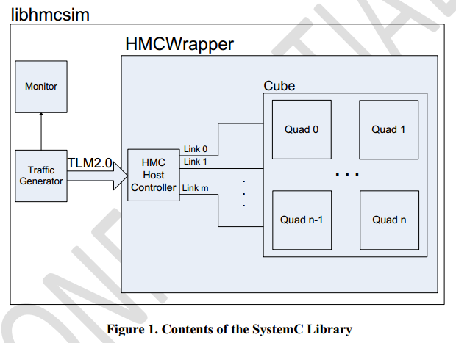
HMC SytemC Simulator - Architecture
Cycle-accurate simulator developed by Micron
Main modules:
Synthetic traffic generator
Host controller
HMCWrapper
Monitor
Traffic Generator
Creates request stream (config.def)
Read-to-write ratio, request buffer size, etc.
Uses TLM2.0 interface to send
read/write requests to host controller
Host Controller
Map requests to links
Create formatted packets (places in corresponding request buffer)
Trace file reader
Parses an input trace file and issues requests to the model
Trace file
Micron Technology, Inc., HMC SystemC Model
Document Revision 1.0 (SVN R194)

Slide 17
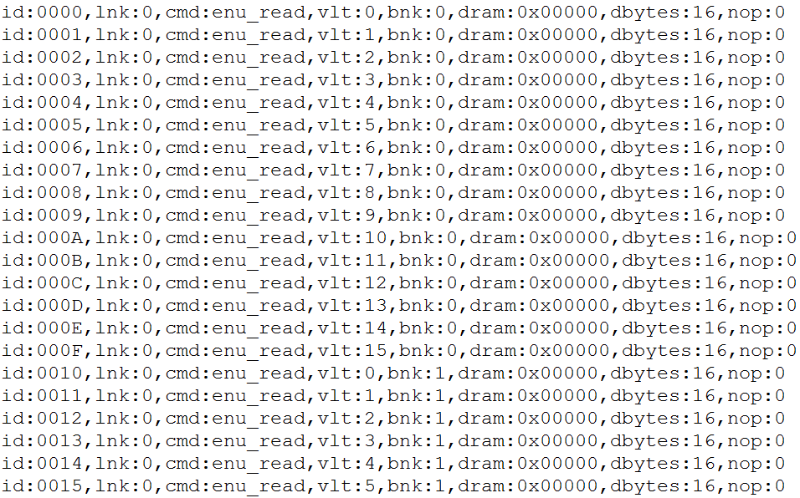
Generated Trace File – For Simulator
Which Vault the request is sent to
Addressing within the DRAM array
Which bank within a vault the request is sent to

Slide 18
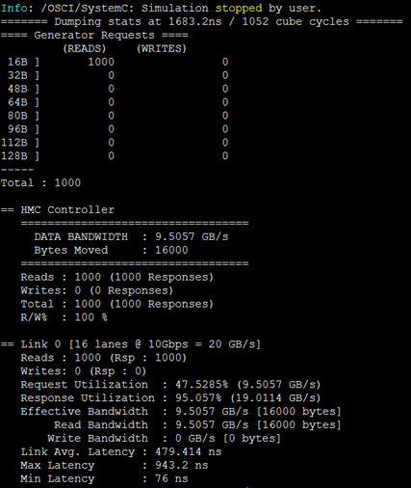
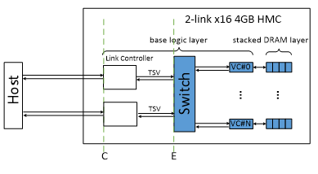
Example Output (1000 memory reads)
Total latency of all request
This value equals point C on the Simulator
The bandwidth and latency calculations are measured on the pins of the HMC (C point in notional CMC architecture)

Slide 19
Validation Experiments
Goal: Validate performance measurement on Merlin board
Approach: Compare
Merlin board measurement
HMC SystemC simulator results
Merlin board
Experiments:
Comparison of average latency of single memory access
Comparison of average latency of single memory access (alternative method)
Comparison of total overlapping latency
SystemC HMC Simulator

Slide 20
Exp. 1: Avg. Latency, Single Memory Access
Measurement on Merlin board
4. Calculate average (1000 accesses) latency & compare with avg. latency reported in SystemC simulator
2. Input memory trace to simulator
3. Measure latency of each single memory access at M3
Simulation on HMC Simulator
1. Collect memory trace of HT

Slide 21
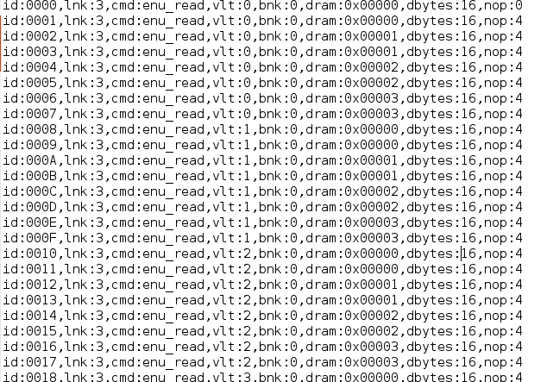
Collected Memory Trace from HT
non-optimal; consecutive access to same bank same vault

Slide 22
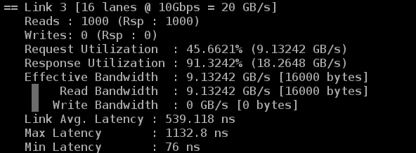
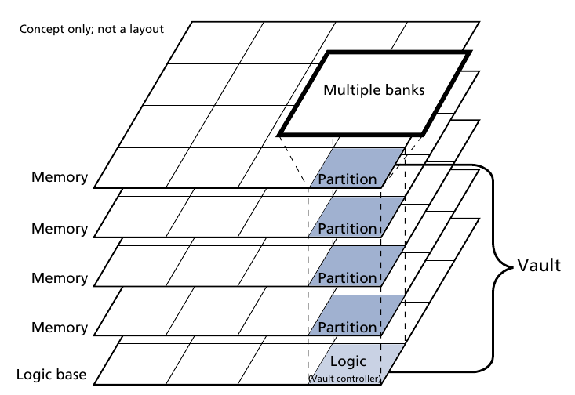
Optimal Memory Trace
Telecon with Dan (Micron engineer responsible for SystemC simulator) about result interpretion
Accuracy of simulator depends on input memory trace
Optimal memory trace results in best performance & accuracy (~10% difference)
Optimal: to fully utilize internal parallelism of HMC, rotate vault address first, then bank address, and then byte address
different vaults could work in parallel
different bank could work in pipeline
need optimal trace file

Slide 23
Example of Optimal Trace File
Which Vault the request is sent to
Addressing within the DRAM array
Which bank within a vault the request is sent to

Slide 24
Exp. 1: Avg. Latency, Single Memory Access
Measurement on Merlin board
4. Calculate average (1000 accesses) latency & compare with avg. latency reported in SystemC simulator
3. Measure latency of each single memory access at M3
2. Convert memory trace to HT address
Simulation on HMC Simulator
1. Input optimal memory trace into simulator

Slide 25
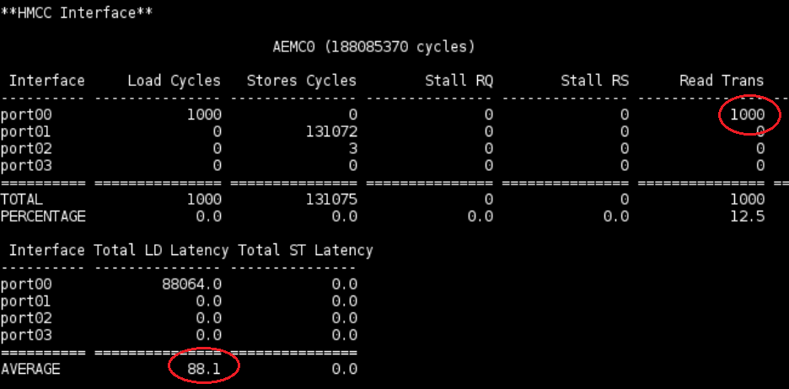
Exp. 1: Avg. Latency, Single Memory Access
Difference comes from HMCC (serialization and deserilization)
Merlin board frequency:167 MHz
Avg. Latency measured over 1000 memory read requests
tM3 Measured at M3 point on Merlin board: 88.1 * 6 ns = 528.6 ns
tC = Determined from SystemC Simulator: 479.414 ns (equivalent to M5)
Notes:
Make clear the point that we are measuring M3 on the Merlin board and
System C is giving result for C, which is equal to M5
Therefore M3 is a little bit larger M5 (consistent with our expectation)

Slide 26
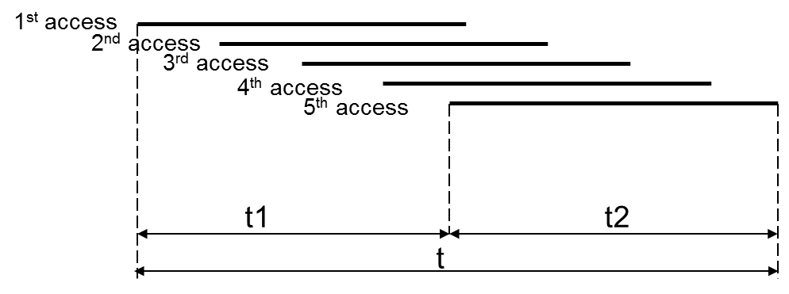
Exp. 2: Avg. Latency, Single Memory Access (Using overlapping memory requests)
Measurement on Merlin board
Measure M3
overlapping memory request
T: time between first req. and last rsp.
D: time between first req. and last req.
T and D are measured by 2 different PERFMON counters at M3 point
L = T – D
L equals latency of single memory request
Execute code 10000 times to calculate L_{avg}
L_{avg} should be comparable to tC Avg. Latency reported in SystemC simulator (next slide)
D
L
T

Slide 27
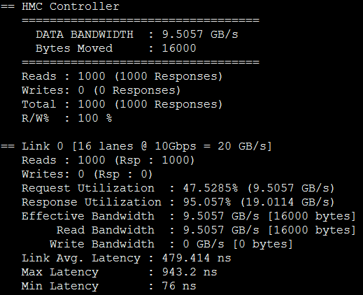
Experiment 2 Results
SystemC simulator results
1000 Memory read requests
Link Avg. Latency = 479.414 ns
Measured results from Merlin board
Results will be reported when Merlin board comes back online
Conclusions: (expected)
Measured results are close to simulator results
Validate modified PERFMON code for this case
Notes:
MADE CHANGES

Slide 28
Experiment 3 Description
Measure T (total latency) at M1
Hypothesis
In overlapping access (already validated by measurement)
M1 = M2 = M3 = (M4 = M5 = E’)
In HMC
M5 = C
E = E’
Expect: M1 = M5 (= E’) = C = E (from HMC simulator)
D
L
T

Slide 29
Experiment 3 Setup
Measurement on Merlin board
2. Convert memory trace to HT address
Expect: M1= M5 (= E’) = C = E (from HMC simulator)
Simulation on HMC Simulator
1. Input optimal memory trace into simulator
* DRE: Data rearrangement/reordering engine ** CMC Computational Memory Cube

Slide 30
Experiment 3 Results
SystemC simulator results
1000 Memory read requests
Total overlapping latency
1683.2ns
Measured results from Merlin board
Results will be reported when Merlin board comes back online
Conclusions: (expected)
Measured results are close to simulator results
Notes:
MADE CHANGES

Slide 31
SystemC Simulator : Other Experiments
Increasing the request count to ~10k
Simulator produces more accurate results
Implement NOP (No-Operation) on hardware
Nop means sending Null FLITs on the Link
Read request takes one FLIT but a read response needs two FLITs, so higher Response Utilization
Nop helps reduce the response traffic at the expense of slightly reduced bandwidth
Multiplexing Read and Write requests
Produces better results
Write takes one Req. and one Res. FLIT
Notes:
Title ???

Slide 32
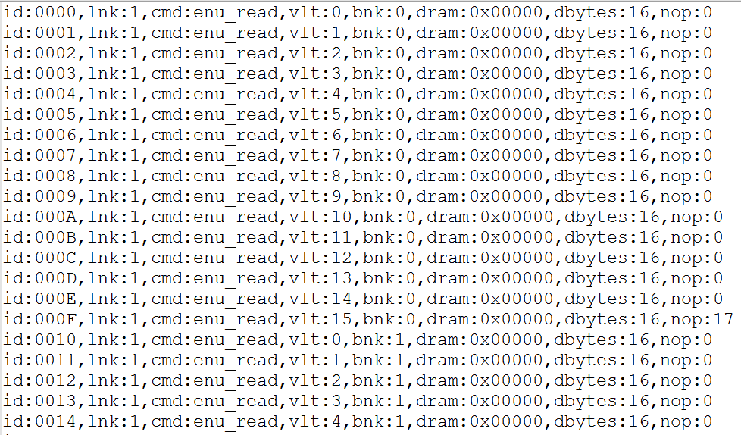
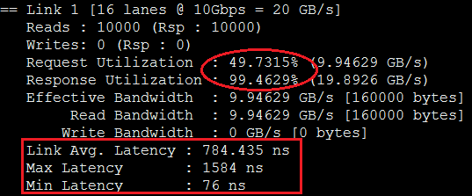
SystemC Simulator : 10k Rd. Requests (NOP)
Add 17 NOPs after every 16 Read requests
Notes:
Title ??

Slide 33
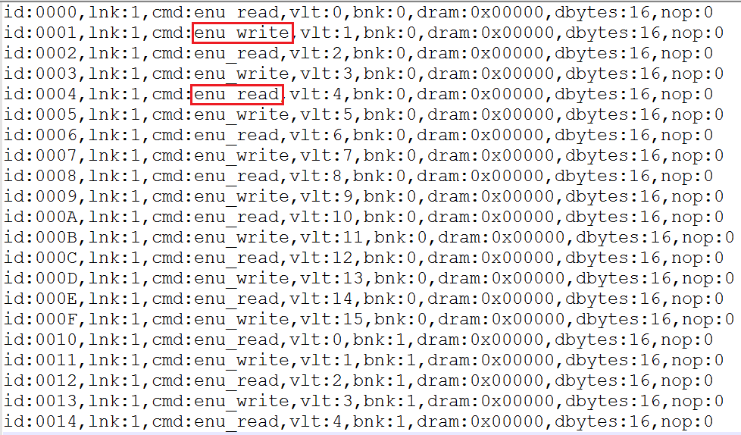
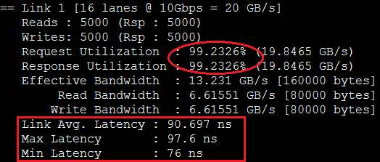
SystemC Simulator : 10k Rd. and Wr. Requests
Notes:
Title ??

Slide 34
Outline
Review & overview
Performance measurements on Merlin board
Mapping notional CMC to Merlin board
Validation of performance measurements on Merlin board
Validation using HMC simulator
Simulator selection (simulators studied)
System C HMC simulator from Micron
System C HMC simulator results
Validation of PERFMON code modification (Convey testbench)
Application exploration using HT
Bloom filter demos
Sorting algorithms
Going forward
* DRE: Data rearrangement/reordering engine ** CMC Computational Memory Cube

Slide 35
Verification of PERFMON Code Modification
M1, M2, M3 are measured in PERFMON
PERFMON – Hardware(Verilog) monitor designed by Convey, modified by CHREC
M4, M5, E’ are not measured
By observing M1 = M2 = M3, we hypothesize M1 = M2 = M3 = M4 = M5 = E’
Goal: to verify M1, M2, M3 are accurately measured in PERFMON

Slide 36
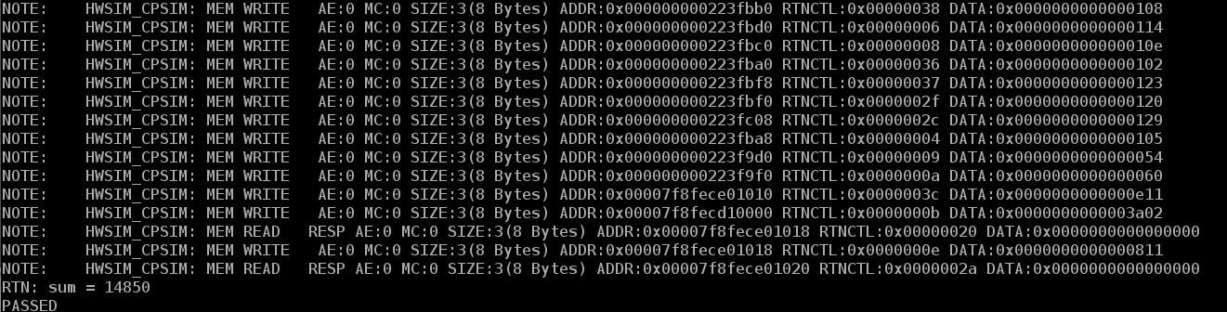
Verification of PERFMON Code Modification
Progress
Set up a RTL simulation of PERFMON in ModelSim, with help from Convey
Verifying reported PERFMON values cycle by cycle in ModelSim

Slide 37
Outline
Review & overview
Performance measurements on Merlin board
Mapping notional CMC to Merlin board
Validation of performance measurements on Merlin board
Validation using HMC simulator
Simulator selection (simulators studied)
System C HMC simulator from Micron
System C HMC simulator results
Comparison to DRE published data
Validation of PERFMON code modification (Convey testbench)
Application exploration using HT
Bloom filter demos
Sorting algorithms
Going forward
* DRE: Data rearrangement/reordering engine ** CMC Computational Memory Cube

Slide 38
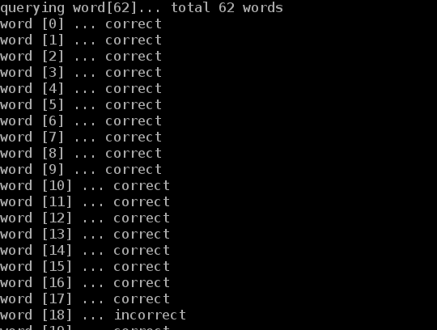
Bloom Filter HT Demos
Spell checker
Input
A dictionary
Words to check
Function
A bloom filter was pre-set using the dictionary
A new word was compared against bloom filter to check existence in the dictionary
Output
A wrong spelling is reported if the new word doesn’t exist in bloom filter
HT utilization
1 HT unit

Slide 39
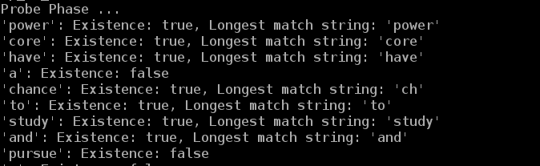
Bloom Filter HT Demos
Content-based deep packet inspection (longest string match)
Input
A group of different-length sensitive words
Packet to inspect
Function
All same-length sensitive words are used to set the same bloom filter
Multiple bloom filters are pre-set
A new packet is compared against bloom filters to check existence of sensitive words
Output
Report the packet contains sensitive information, if matched
HT utilization
16 HT units

Slide 40
Sorting Algorithms
Sorter Architectures
Sorting Networks
Bitonic merge sorter
FIFO-Based Merge Sorter
Merge Sorter Trees
Bucket Sort
Progress

Slide 41
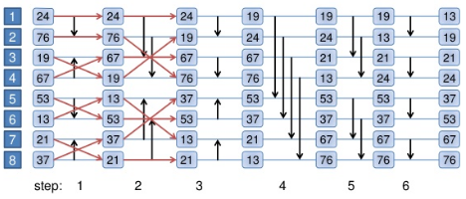
Bitonic merge sorter
Input
Unsorted list of numbers
Function
First convert an unsorted sequence into Bitonic Sequence
Need (log2N) cycles to sort a bitonic sequence with N keys
Output
Sorted list of numbers

Slide 42
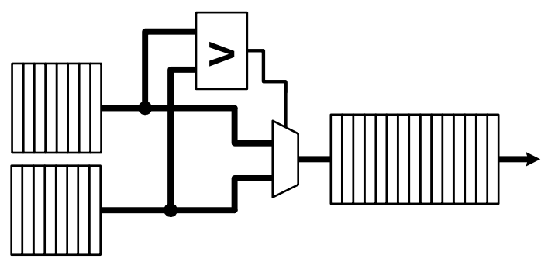
FIFO-Based Merge Sorter - Two Input FIFOs
5 6 8 12 13
Input
Two input FIFOs with sorted list of numbers
Function
Comparator: compares the FIFO entries and produces an output
Multiplexer: Comparator output is used to select the Large ( or small) number
Output
Single output FIFO with sorted list of numbers
1 3 5 6 8 8 11 12 13 17
1 3 8 11 17

Slide 43
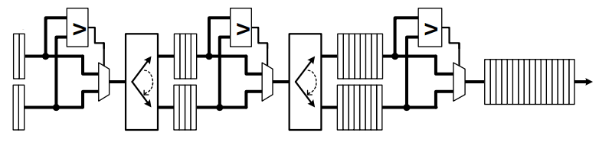
FIFO-Based Merge Sorter - Multiple cascaded FIFOs
Input
Tow input FIFOs with sorted list of numbers
Function
Following functions are performed at each stage
Comparator: compares the FIFO entries and produces an output
Multiplexer: Comparator output is used to select the Large ( or small) number
Output
Single output FIFO with sorted list of numbers

Slide 44
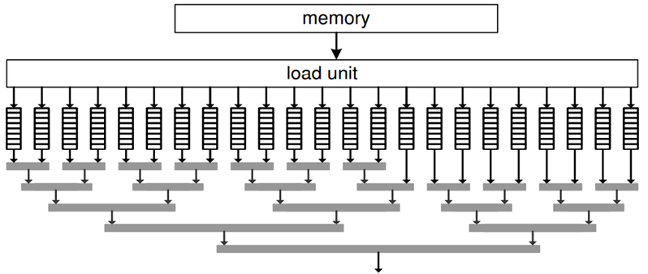
Merge Sorter Trees
Input
Large number of sorted lists to be merged (usually in external memory)
Function
At each horizontal level, two FIFOs are compared to produce one sorted list
Comparator: compares the FIFO entries and produces an output
Multiplexer: Comparator output is used to select the Large ( or small) number
Output
Single output FIFO with sorted list of numbers

Slide 45
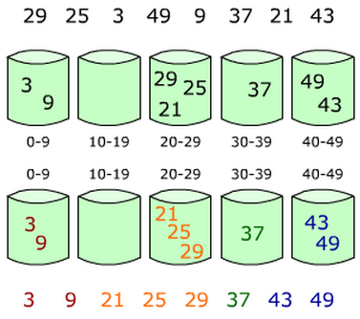
Bucket Sort
Input
List of unsorted numbers
Function
Buckets with different range of
values are created
Based on the specified ranges, each
number goes into one particular bucket
Finally each bucket is sorted
Output
List of sorted numbers

Slide 46
Sorting Algorithms - Progress
Currently implementing host applications for following
Bitonic Merge Sorter
Bucket Sort
These applications are relatively easy to implement in HT language as they do not require lot of on-chip* memory
Exploring FIFO-based merge sorter methods to see if they are efficient as they require more on-chip memory
on-chip* memory : Block RAM on FPGA

Slide 47
Going Forward
F1
Platform development
Complete validation of CMC platform
Complete development & instrumentation of CMC platform
Develop library for customization of notional CMC architecture under study
Create user-friendly CMC API
Explore CMC apps using HT
Case studies to explore
Notional CMC architectures
CMC apps, including:
Data Reordering/Rearrangement Engine, sorting algorithms, bloom filter
Lessons learned, including:
Characteristics of CMC-amenable apps
How to re-factor algorithms to become CMC-amenable
Share code and lessons with LPS
Visit LPS

